Slide 1
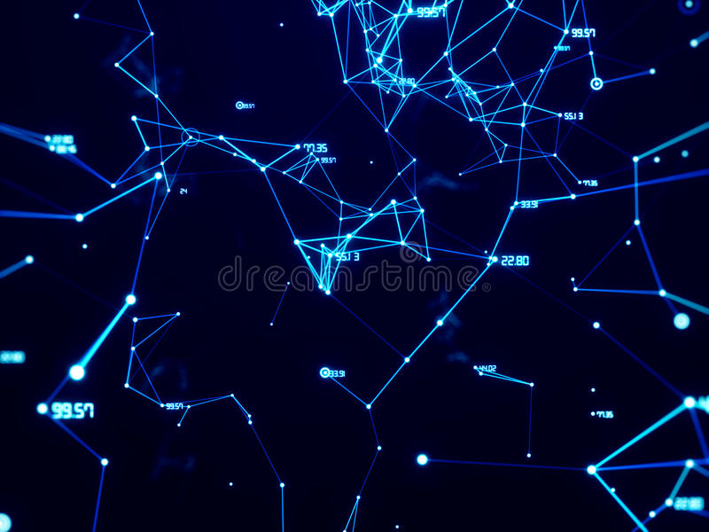
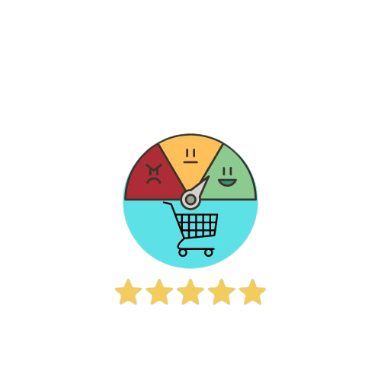
Product Review Analysis

Slide 2
Group details
Student Name | Names
Deepak Grover | deepak.g@atriauniversity.edu.in
Anjali Sharma | anjali.s@atriauniversity.edu.in
Jewel M Jain | jemel.mj@atriauniversity.edu.in
Aman Rathore | aman.r@atriauniversity.edu.in

Slide 3
Objective
The purpose of this project is to simplify the repetitive and time-consuming task of reading comments to decide the worth of a product.
By using code tools like the selenium module in Python for scraping comments, the pandas module for filtering the data, matplotlib for visualizing the data through methods such as word clouds and sentiment plots, and the Tkinter module to create a graphical user interface.
This project aims to give businesses a competitive advantage by saving time for users and directly benefiting the marketing function.

Slide 4
Reason for Choice
As a customer we have seen that if we have to determine the worth of a product the repetitive work of reading comments has to be done.
So, we think about that in deep and come with a solution to solve the problem by making a product review analysis which will automatically generate points or sentiment which a user wants related to that specific product.
These tools were chosen because they are popular, powerful, and well-suited for the tasks required in this project.
They make it possible to scrape and filter the data, create visualizations, and create a user-friendly interface, all with a minimum of effort and coding expertise.

Slide 5
This data visualization prototype utilizes web scraping tools such as Selenium to gather product comments from the internet.
Then, the raw data is filtered to remove any irrelevant information, and a word cloud and sentiment plot are generated to provide an in-depth analysis of the product.
The results, including a detailed description and the visualizations, are displayed in an intuitive and user-friendly graphical user interface (GUI). This allows for easy interpretation of the product's sentiment and making it more convenient for users.
Project Scope

Slide 6
High level requirements
This data visualization project requires the following high-level steps:
Scraping product comments using the Selenium module in Python.
Filtering the raw data using the Pandas module to remove any irrelevant information.
Plotting a graph using the Matplotlib module to visualize the sentiment and frequency of the comments.
Creating an interactive graphical user interface (GUI) using the Dash module in Python to present the results in a user-friendly manner.
This project aims to provide an in-depth analysis of a product by collecting and processing the comments, and presenting the results in a word cloud and plot form.

Slide 7
Technologies / language / Tools used :-
Python :-
Modules :-
1. Selenium
2. Selenium webdriver
3. Pandas
4. Matplotlib
5. Tensorflow
6. Tkinter

Slide 8
Selenium: Selenium is a popular web scraping tool that allows you to automate web browsing tasks, such as accessing websites, filling forms, and clicking buttons. This makes it an ideal choice for scraping comments on products, as it can easily access the relevant pages and extract the comments.
Pandas: Pandas is a powerful library in Python that provides easy-to-use data structures and data analysis tools. In this project, we have used it for filtering the raw data collected by Selenium, allowing you to clean and organize the data in a way that is useful for your analysis.
Matplotlib: Matplotlib is a data visualization library that provides a variety of tools for creating visualizations, including bar plots, scatter plots, and word clouds. In this project, we have used it for creating visualizations of the comments, such as word clouds to show the most commonly used words and sentiment plots to show the overall sentiment of the comments.
Tkinter: Tkinter is a built-in GUI toolkit for Python that allows you to create graphical user interfaces for your applications. It is a simple and easy-to-use toolkit that makes it possible to create a user-friendly interface for the analysis process, making it easier for users to access and understand the insights generated by the analysis.
Uses of these tools in our project :

Slide 9
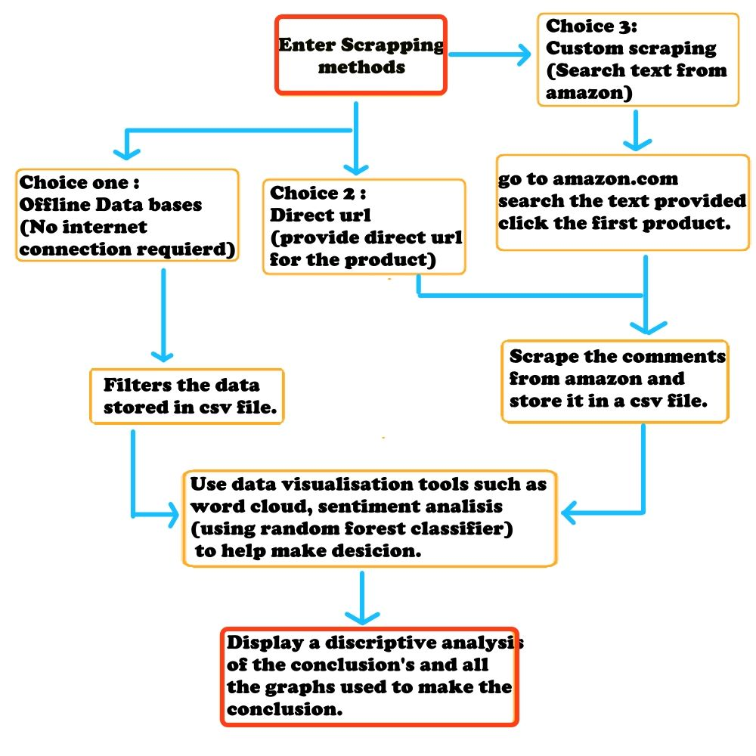
Project >analyzing amazon comments and reviews >

Slide 10
Workflow
Data Collection: Collection of relevant comments and data for the product through web scraping using the Selenium module.
Data Filtering: Filtering of raw data using the Pandas module in Python to ensure that the data used for visualization is clean and accurate.
Data Visualization: Plotting of the word cloud and sentiment analysis graph for the product using the Matplotlib module in Python.
GUI Design: Development of a user-friendly GUI using the Dash module in Python, which will display the data visualization and provide options for the user to choose whether they want the visualization with sentiment analysis or without.
Image Delivery: Generation of a JPEG file containing the word cloud and sentiment analysis graph for the product, which will be delivered to the user.

Slide 11
Technical Limitations: The data visualization process may encounter limitations that could affect its accuracy. Additionally, the web scraping process using Selenium may not always be uptomark or may be some exceptions may go unnoticed.
User Experience: The goal is to design an intuitive and user-friendly GUI, but this may prove to be challenging in the creation of a working prototype. Enhancing the user experience could include implementing a small pop-up feature on the website, but this would require additional effort to execute effectively.
Data Availability: The availability of comments and other relevant data for the product may be limited, which could affect the accuracy of the data visualization.
Time Constraints: There may be time constraints on the development and implementation of the data visualization prototype, which could limit the features that can be included.
Constraints

Slide 12
Final Deliverables
The deliverable for this project is a graphical user interface (GUI) prototype that will allow users to input a product name or URL and choose whether they want sentiment analysis to be included in the data visualization.
Upon giving a input for product, the prototype will deliver a JPEG image that contains both a word cloud and various plots that represent the analyzed data.
The visualization will present a clear and concise representation of the product's comment data, providing valuable insights into the product's strengths and weaknesses as perceived by its users in the word cloud and plots.

Slide 13
Thank you

